Slide 1

Introduction to Vector-Borne Diseases
CBS 810
Instructor: Shi Chen
Notes:
No mosquitoes allowed.

Slide 2
Warm-up: the Epidemiology Triad
HOST
VECTOR
PATHOGEN
ENVIRONMENT
Notes:
Three major components that comprise the triad. Directly transmitted (host-host) or indirectly transmitted (via environment)

Slide 3
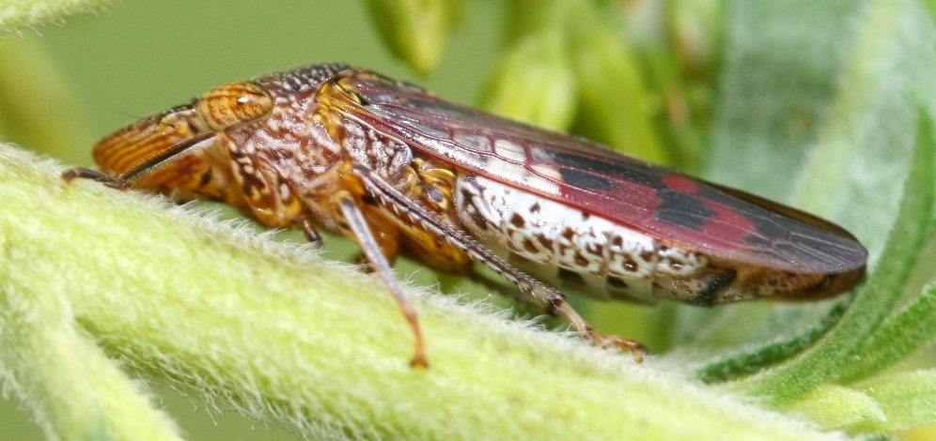
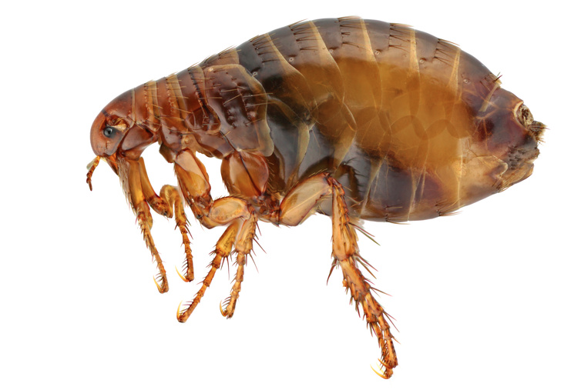
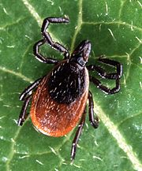
The “Vector”
Vector: an agent that carries and transmits infectious pathogen into another living organism.
Notes:
Grasswing sharpshooter (GWSS); flea (black death- plague); tick (lyme disease)
Comparing with “host”? vector becomes “infectious” but they are not really “infected” because they do not show symptoms – on the other word, the pathogen is like parasites and just utilizes the vector body.

Slide 4
Zoonotic and VBD
NOT mutually exclusive
Vector-borne zoonotic disease
Zoonotic
VBD
Rabies
West Nile
Malaria
Notes:
Why there are so many vector borne zoonotic diseases? Why need a vector?
Plague – the black death. probably the most notorious VBZD.

Slide 5
Zoonotic and VBD
Zoonotic Disease:
Multiple host, does not need vector necessarily
Vector-borne Disease (VBD)
Disease transmitted by vectors
Vector-borne and Zoonotic Disease
Notes:
Zoonotic: more than one host (species/population); direct bite: rabies (no vector needed)
Vector borne disease: must include vector in disease/pathogen transmission

Slide 6
Malaria: the No.1 VBD
219 Million Cases
660,000 Death
200,000 Infant Death
85-90% Fatality Rate (Sub-saharan Africa)
2010 WHO Estimate
Notes:
1 death per minute

Slide 7
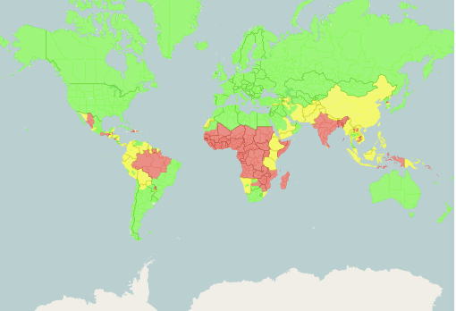
The Malaria Risk Map
http://cdc-malaria.ncsa.uiuc.edu/
Notes:
Darker the color

Slide 8
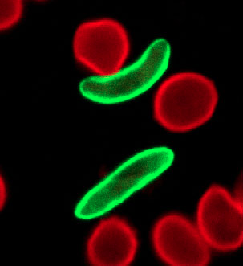
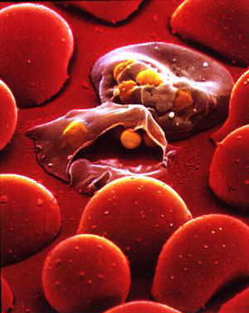
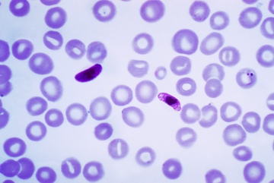
Malaria: the Pathogen
Plasmodium falciparum
protozoa (unicellular eukaryotic)
Notes:
single cell, but possess cellular structures. Bacteria are prokaryotic (no cellular structure); virus doesn’t even have a cell.

Slide 9
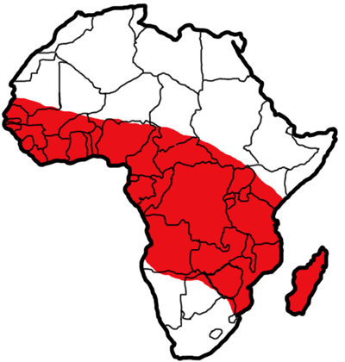
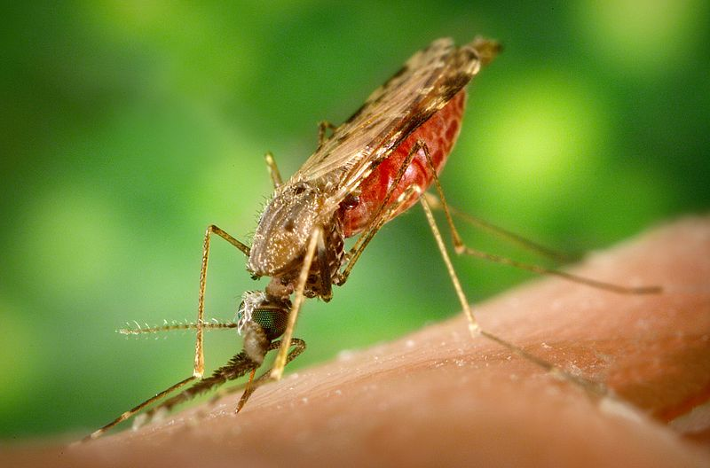
Malaria: the Vector
Anopheles gambiae mosquito
Notes:
Take a look at malaria map and A. gambiae distribution map. What can you infer?
Scientific name: genus and species. Human: homo sapiens.

Slide 10
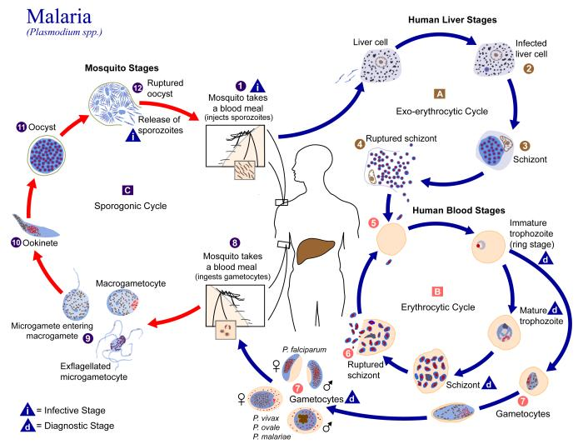
Life History of Malaria Pathogen
Notes:
Specific vector: complete life history within the vector
Vector or host? We do not model each of this process (very complicated process, even hidden process that we are not currently knowing or understanding). Why?

Slide 11
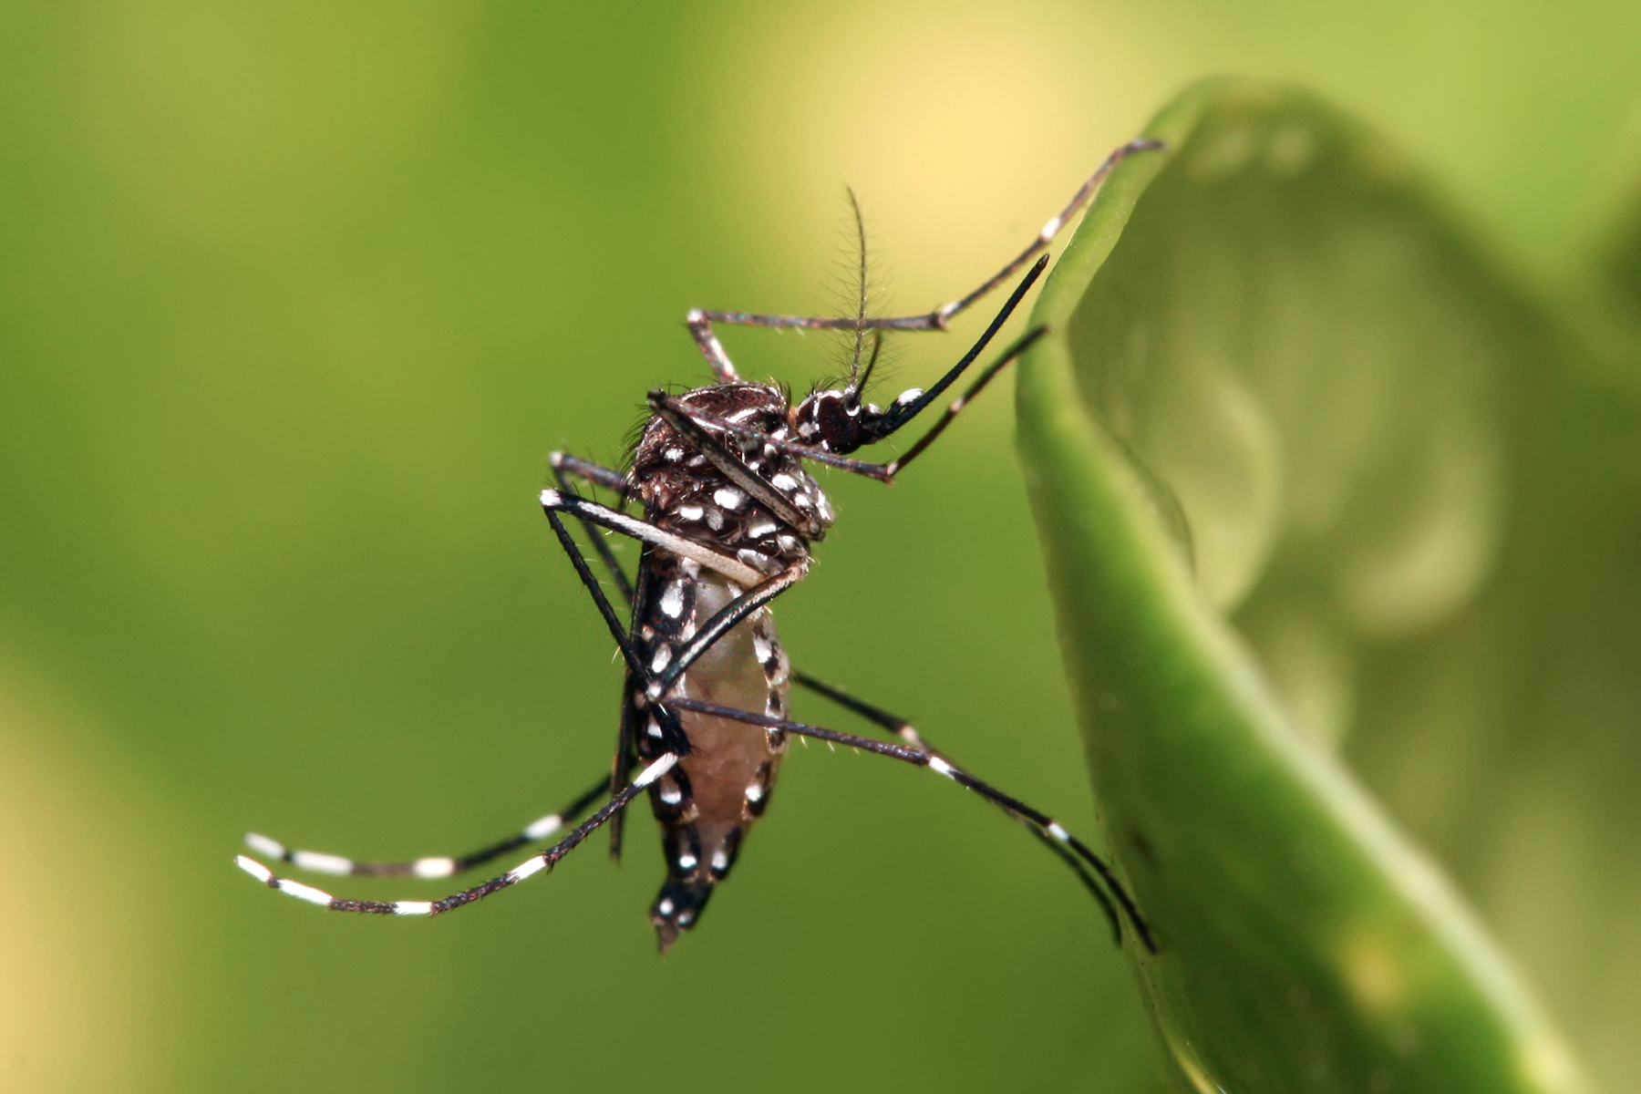
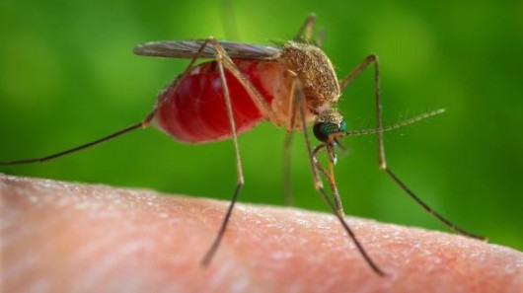
Other Important VBD
Mosquito-borne
Dengue fever/Aedes spp./Dengue virus
West Nile encephalitis/Culex spp./West Nile virus
Notes:
Difference: aedes (tiger mosquito) have distinctive pattern; hind legs usually up when resting and feeding.

Slide 12
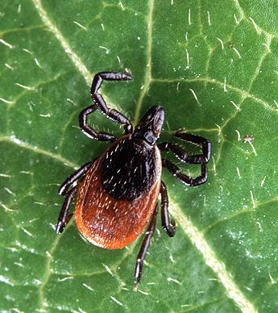
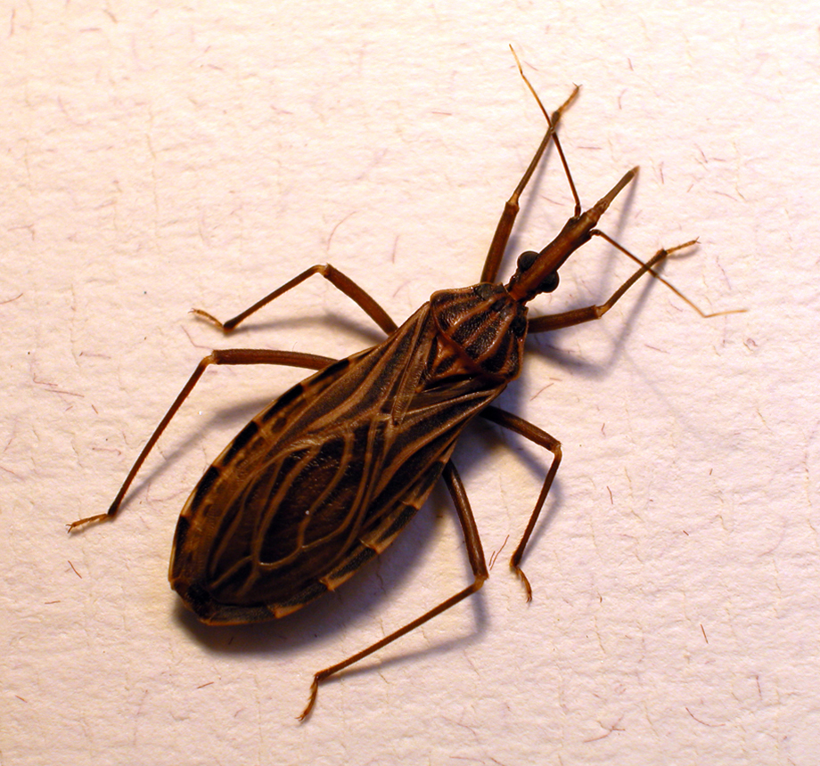
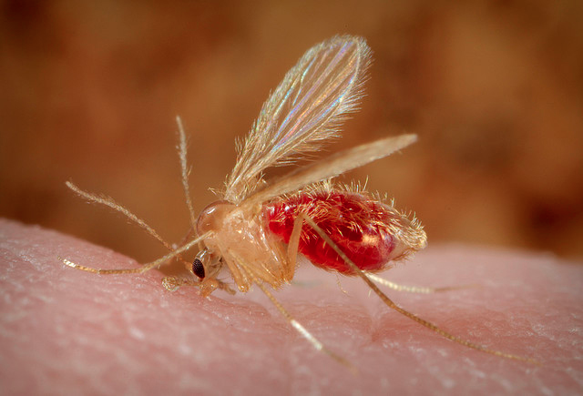
Other Important VBD
Lyme disease/deer tick/Borrelia spp.
Chagas disease/kissing bug/Trypanosoma cruzi
Leshimaniasis/sand fly/Leshimania spp.
Notes:
Chagas and leshimaniasis disease: protozoa; lume: bacteria (fever, headache, fatigue); Chikungunya: virus (by aedes) similar to dengue; plague bacteria (by flea) – most notorous vbzd.

Slide 13
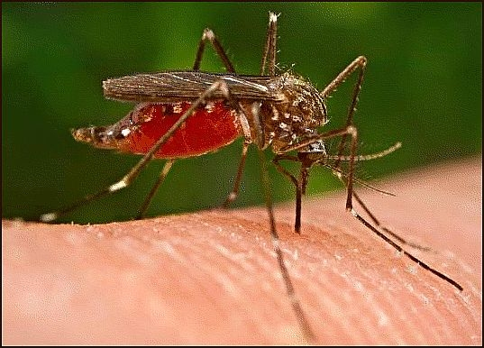
Modeling for VBD
Host Dynamics (H)
S_{H} → I_{H} → R_{H}
Vector Dynamics (V)
S_{V} → E_{V} → I_{V}
Notes:
Why do we need an exposed stage for vector? (Biological and mechanical vector difference… whether or not the pathogen can replicate within the body of the vector)
Most important event: biting
Comparing with original SIR model: contacting
SH+IV=IH; SV+IH=EV Try to write the diagram

Slide 14
The Transmission Process
Not all bites are equal…
Infection of host:
Susceptible host bitten by infected vector
SH+IH=IH
Infection of vector:
Susceptible vector bites infected host
SV+IH=EV
Notes:
Consider the SEIR model: dE/dt=beta*S*I
Note: probability of infection – where stochasticity comes from!

Slide 15
Model Simplicity vs Accuracy
Assumptions of the Model
Constant biting rate through time
Ignore within-host dynamics
Ignore external variables (T,RH,etc)
Try to spot some flaws in this model system

Slide 16
Exercise
1. Write down the system equations for the VBD system
(Hint: what is the most important event in VBD transmission?)
2. Simulate the VBD in R and try to derive the basic reproduction number (R0).

Slide 17
# ODE vector-borne disease system
library("deSolve")
parms <- c(beta1=1e-3, gamma=1e-1, beta2=1e-4, mu=1e-1)
inits <- c(SH=499,IH=1,RH=0,SV=1990,EV=0,IV=10) # H for host, V for vector
dt <- seq(0,100,0.1)
VBD <- function(t, x, parms){
with(as.list(c(parms,x)),{
dSH <- -beta1*IV*SH
dIH <- +beta1*IV*SH – gamma*IH
dRH <- gamma*IH
dSV <- -beta2*IH*SV
dEV <- beta2*IH*SV – mu*EV
dIV <- mu*EV
der <- c(dSH, dIH, dRH, dSV, dEV, dIV)
list(der) # the output must be returned
}) # end of ’with’
} # end of function definition
sim.vbd <- as.data.frame(lsoda(inits, dt, VBD, parms=parms))
plot.ts(sim.vbd$IV,lwd=2,ylim=c(0,1000))
lines(c(1:1001),sim.vbd$IH,col="blue",lty=2,lwd=2)
leg.txt<-c("Infectious Vector","Infected Host")
legend("topright",leg.txt,lty=c(1,2),col=c("black","blue"))

Slide 18
